Slide 1
ONE Lexington

Slide 2
PIER Network
ONE Lexington is guided by the PIER network.
P – Prevention
I – Intervention
E – Enforcement
R – Re-entry

Slide 3
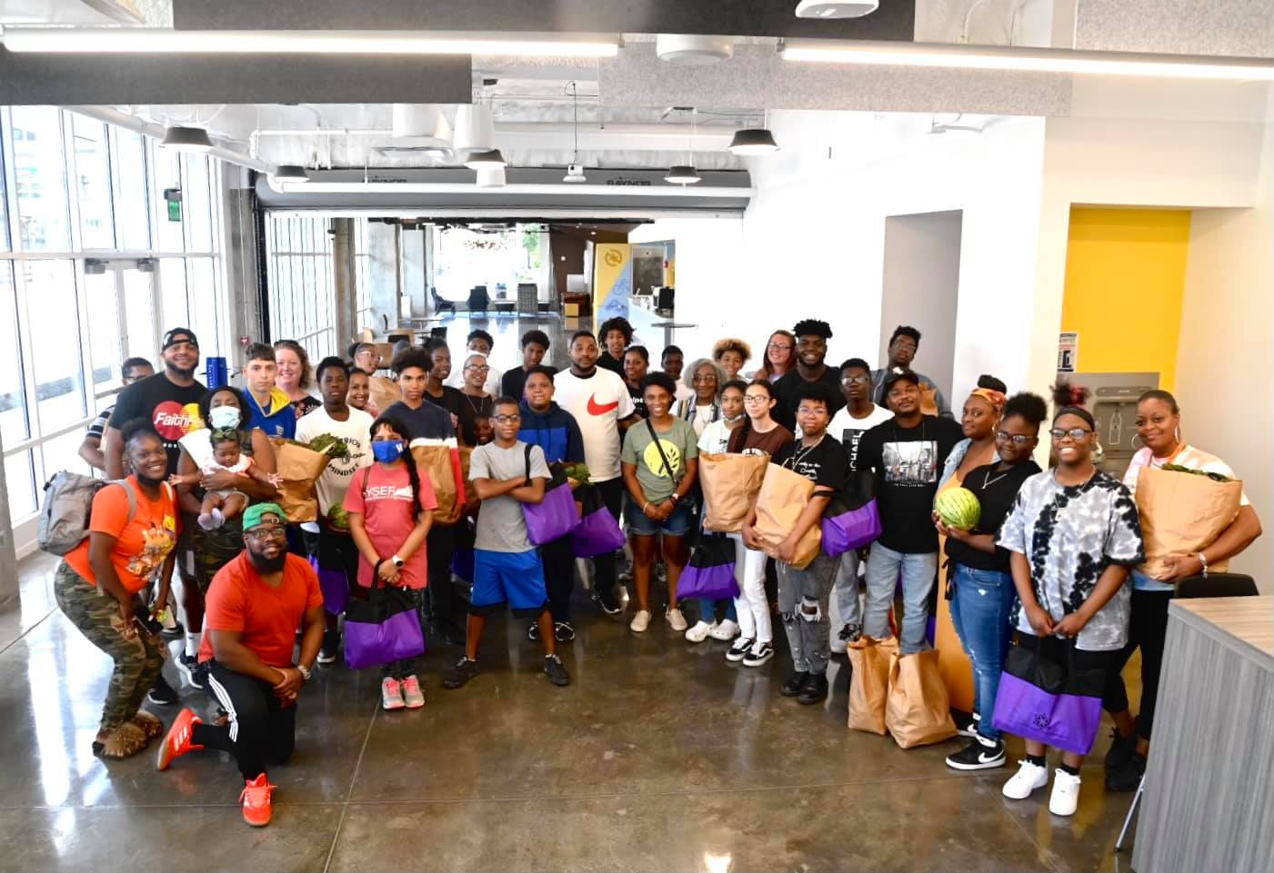
It Takes A Village Summer Youth Program
Weekly summer mentoring program for youth aged 12-17.
Weekly in-school mentoring program at Frederick Douglass High School, MLK Academy of Excellence, Winburn Middle School, and William Wells Brown Elementary School.
Provides educational and workforce opportunities paired with recreational activities.
Allows for underserved youth to engage in positive activities during the summer months.
Goal is to steer youth away from violence by showing that life can be more than their current circumstance.

Slide 4
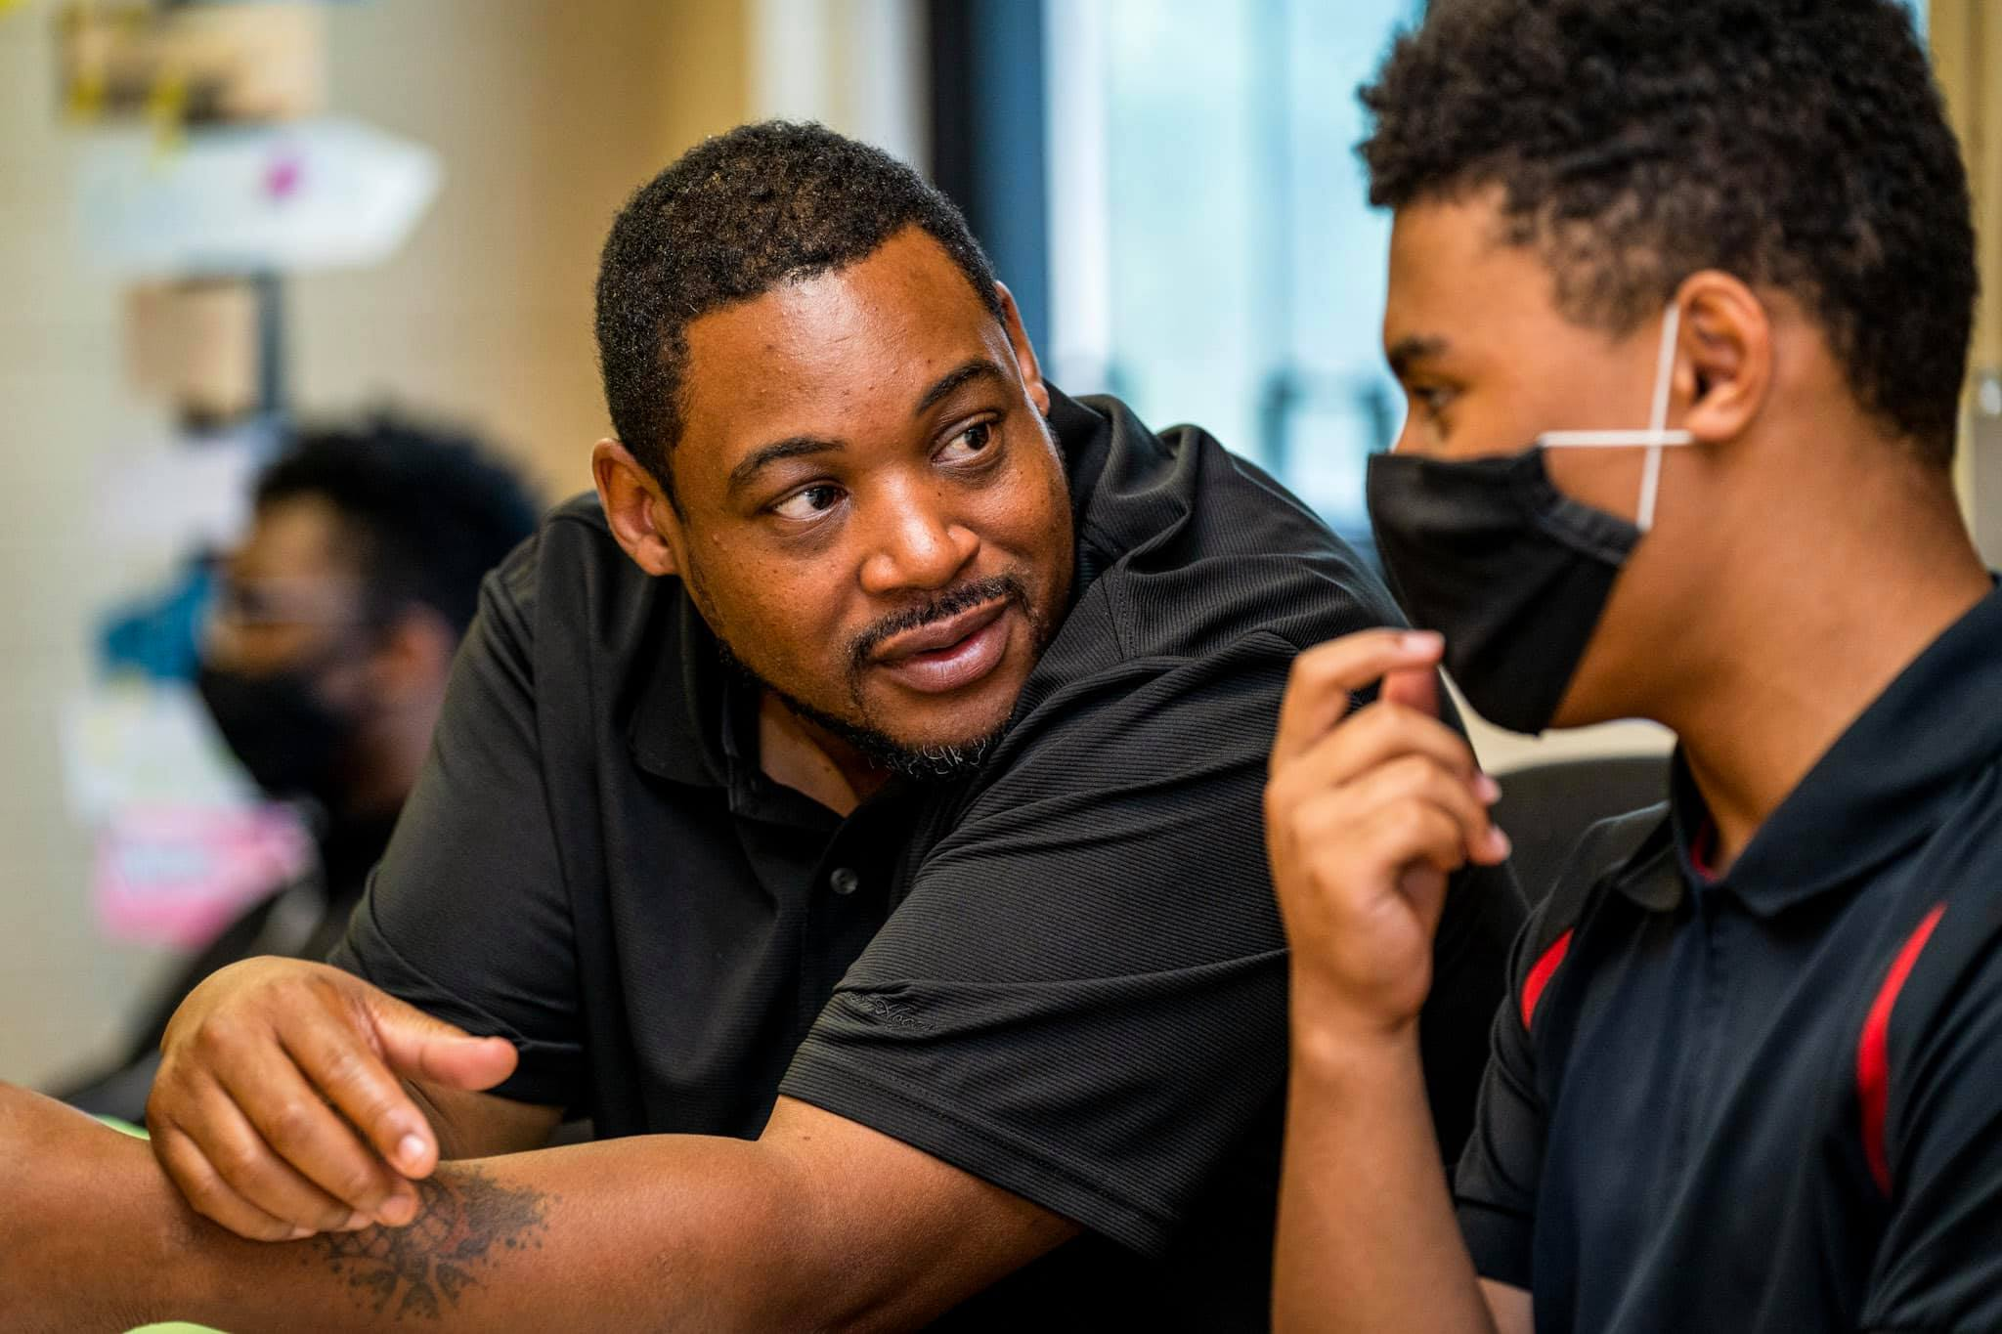
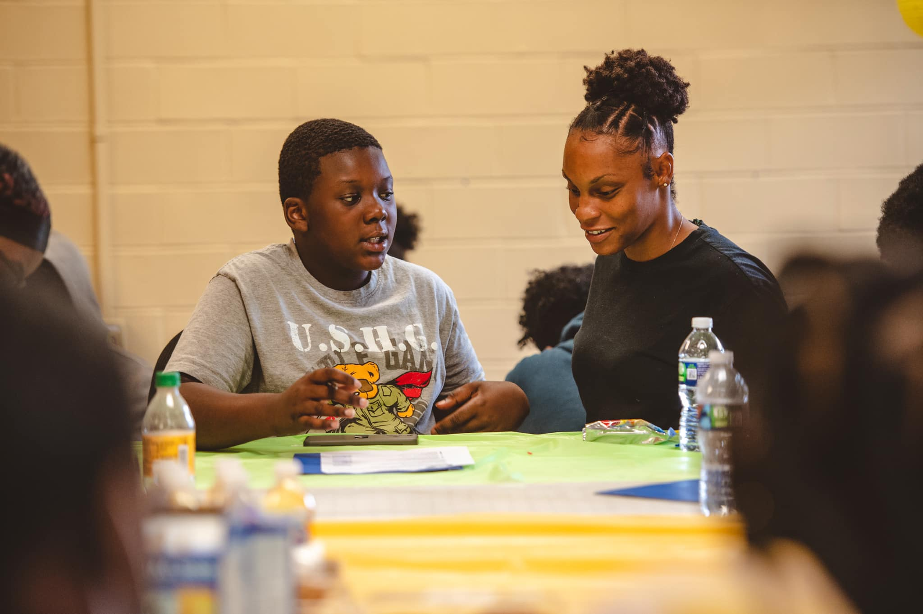
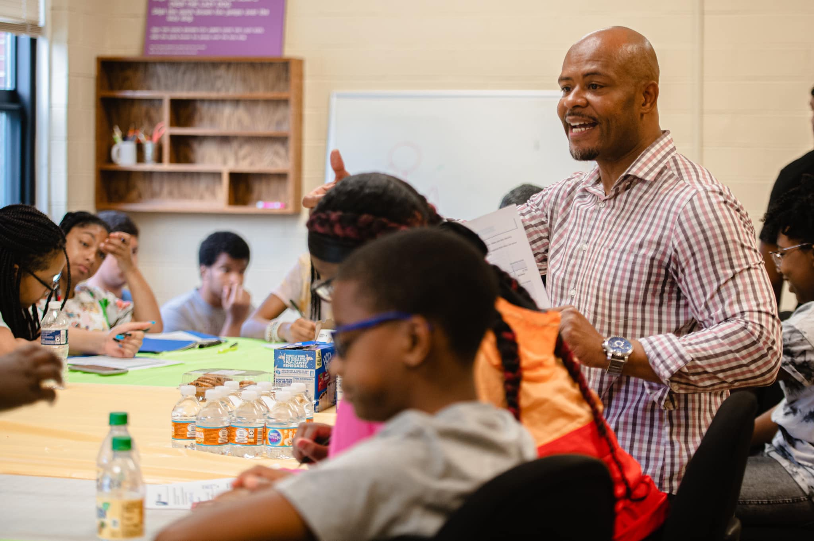
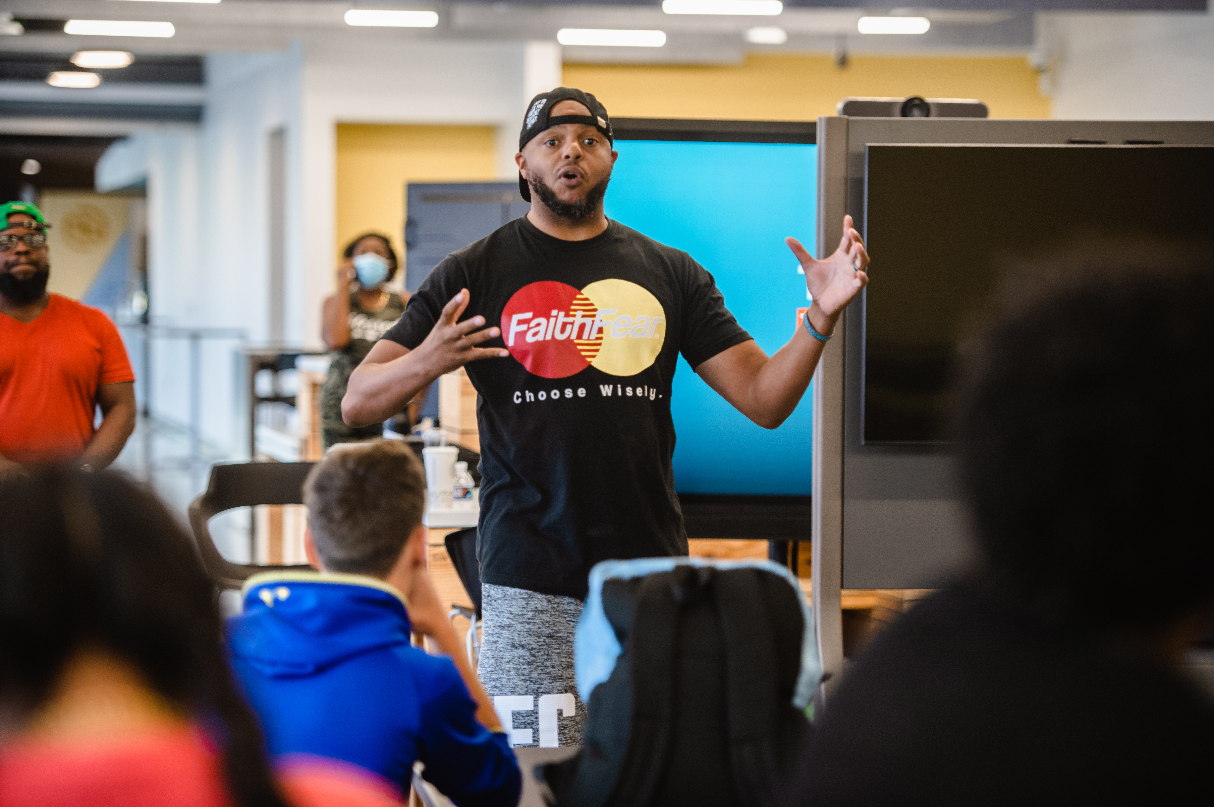
Skill Building Workshops
It Takes A Village

Slide 5
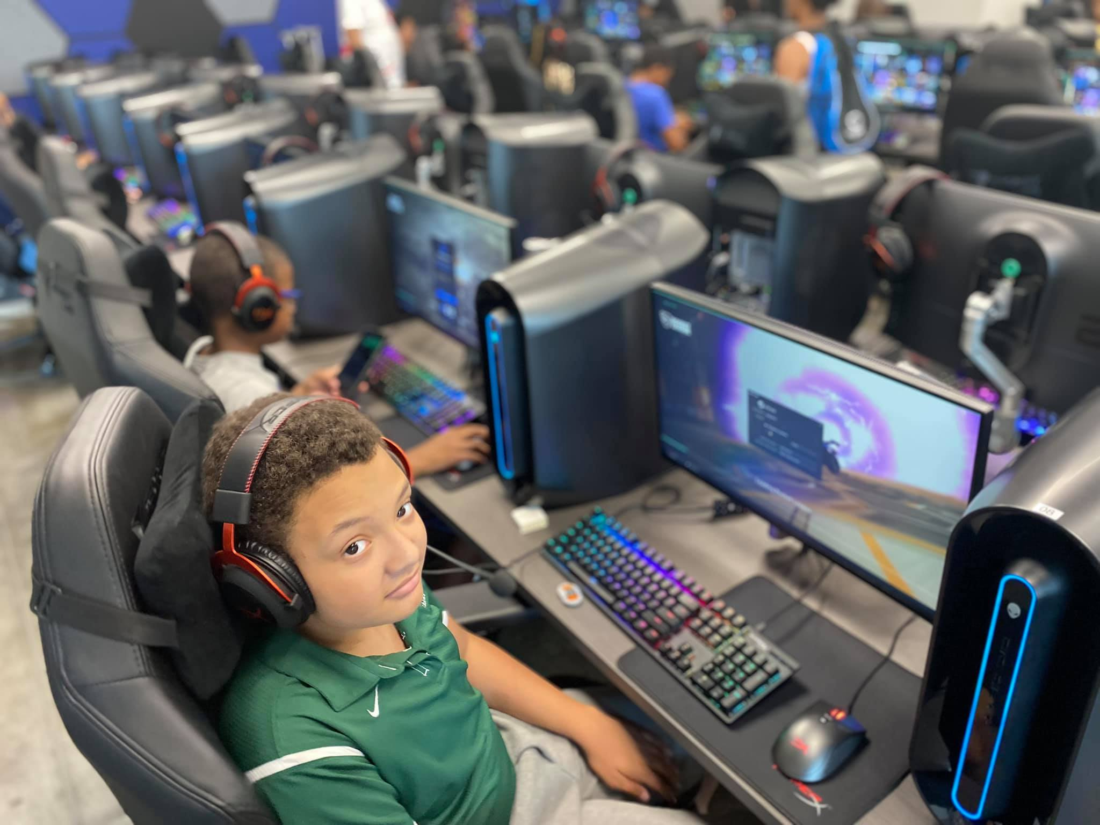
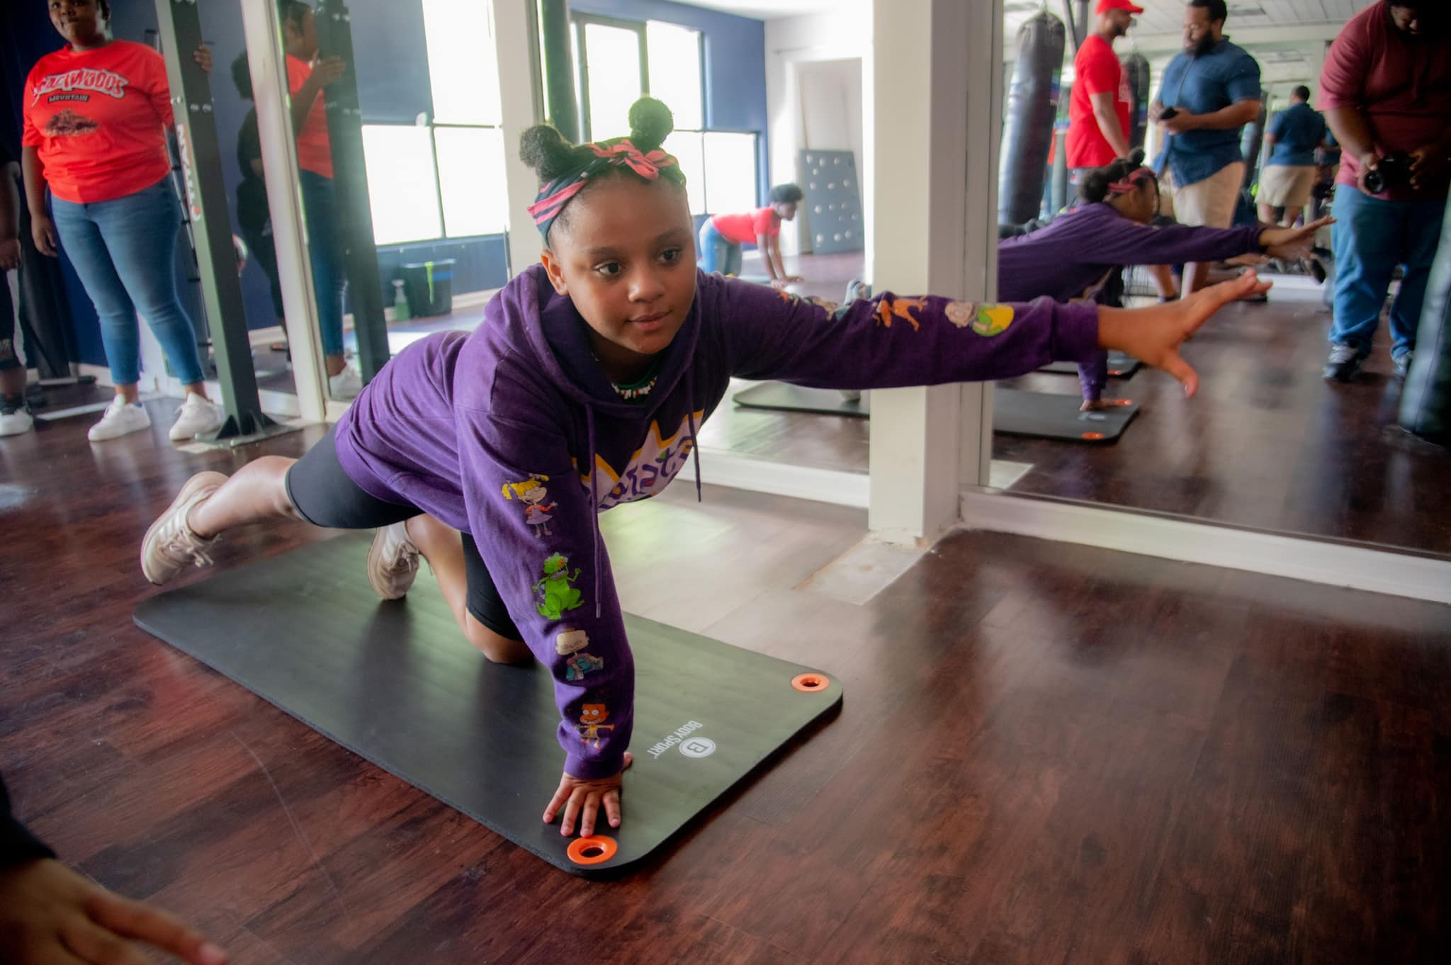
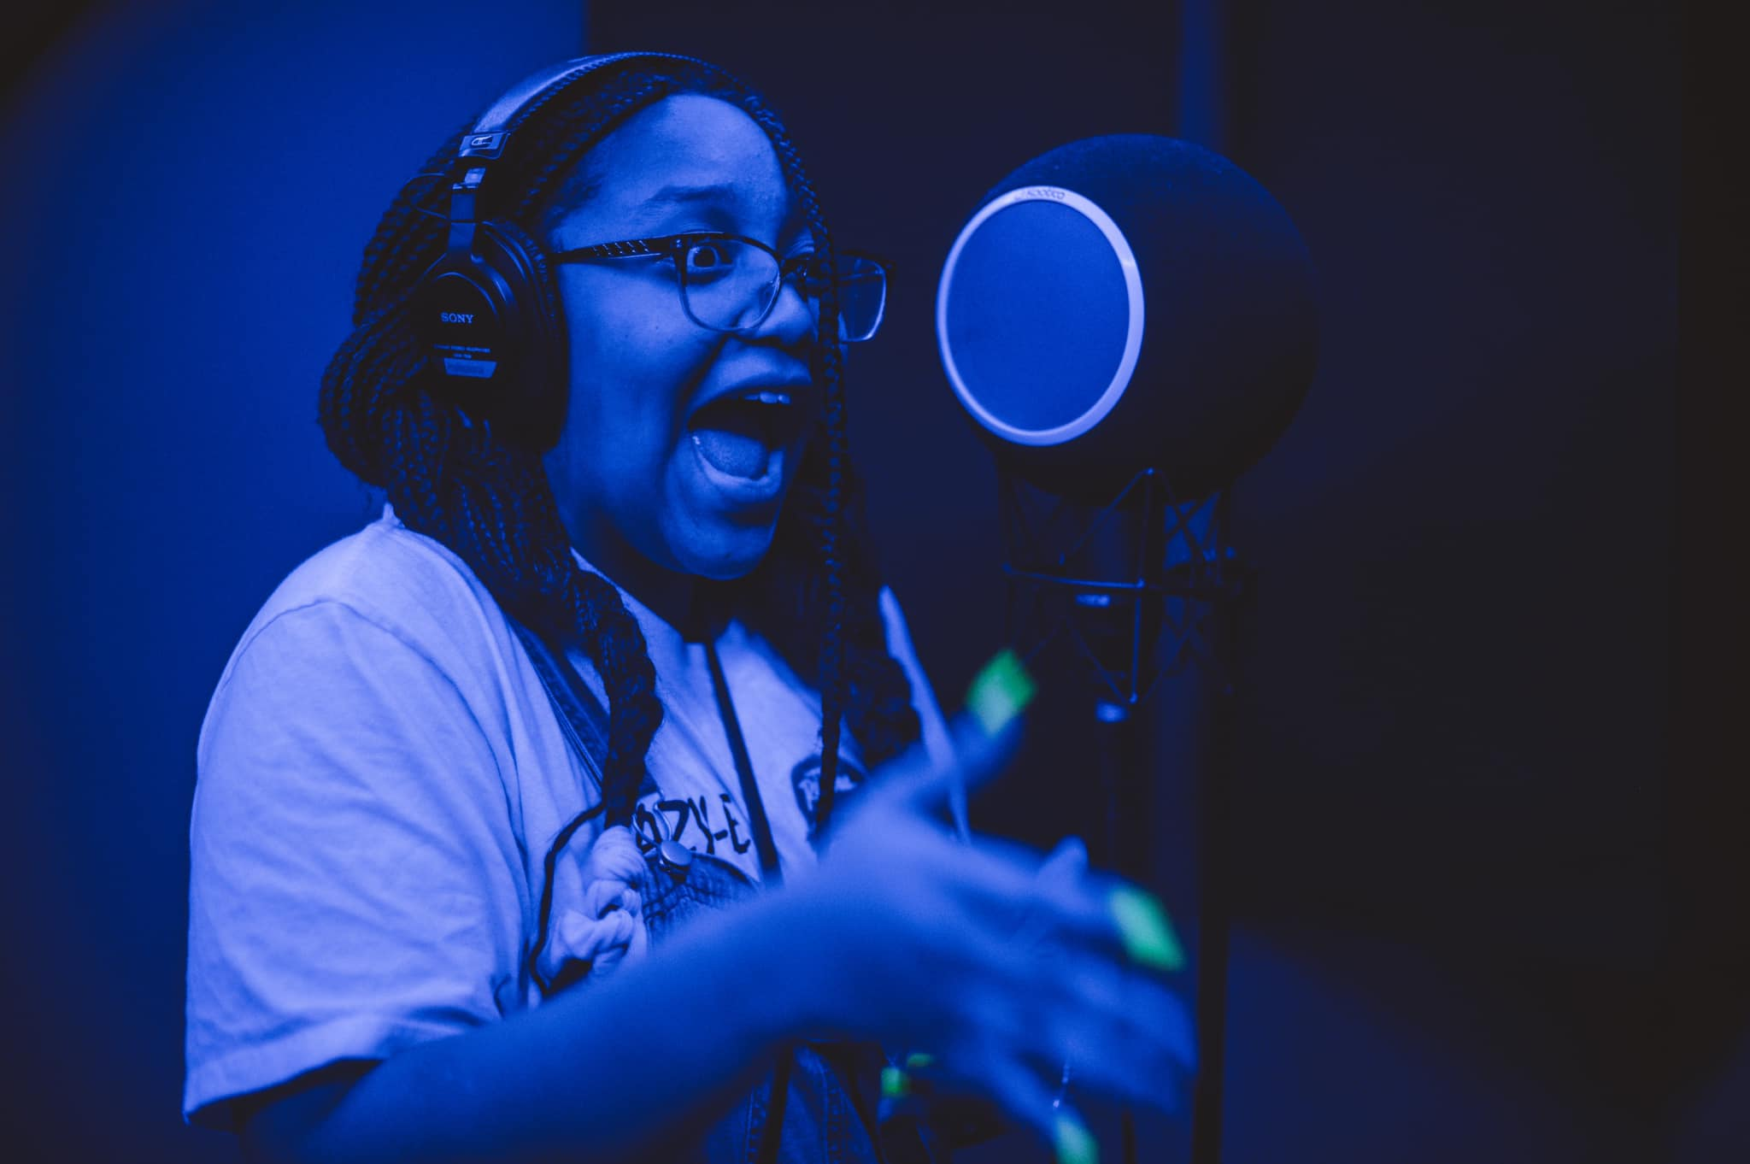
Building Relationships
It Takes A Village

Slide 6
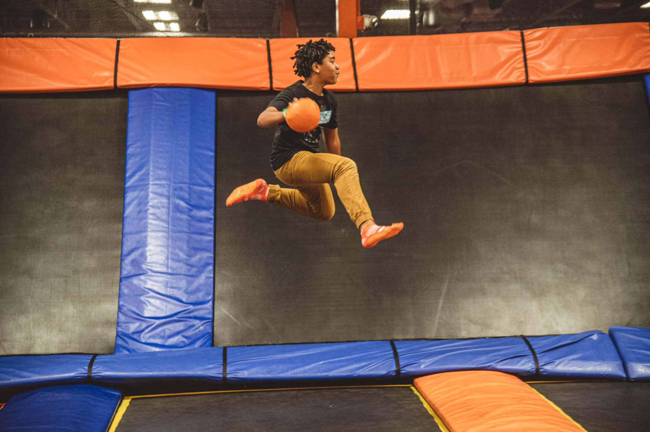
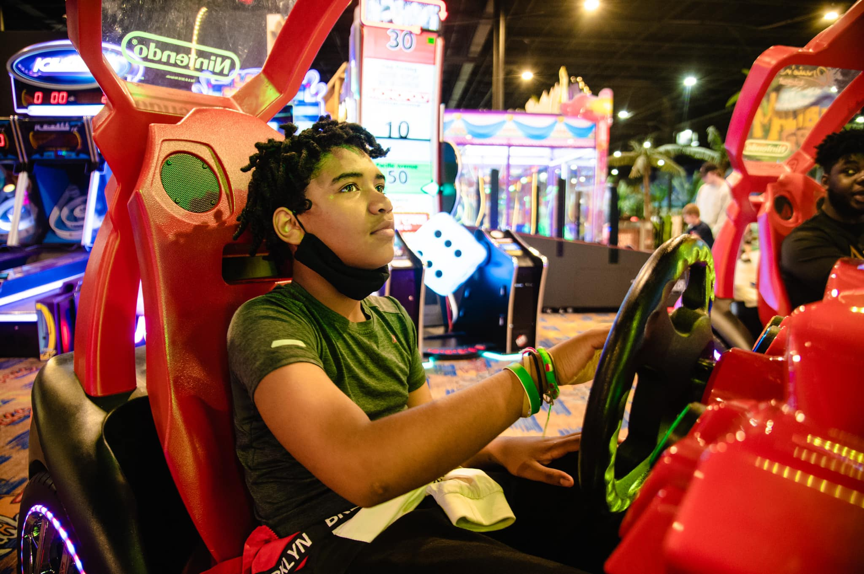
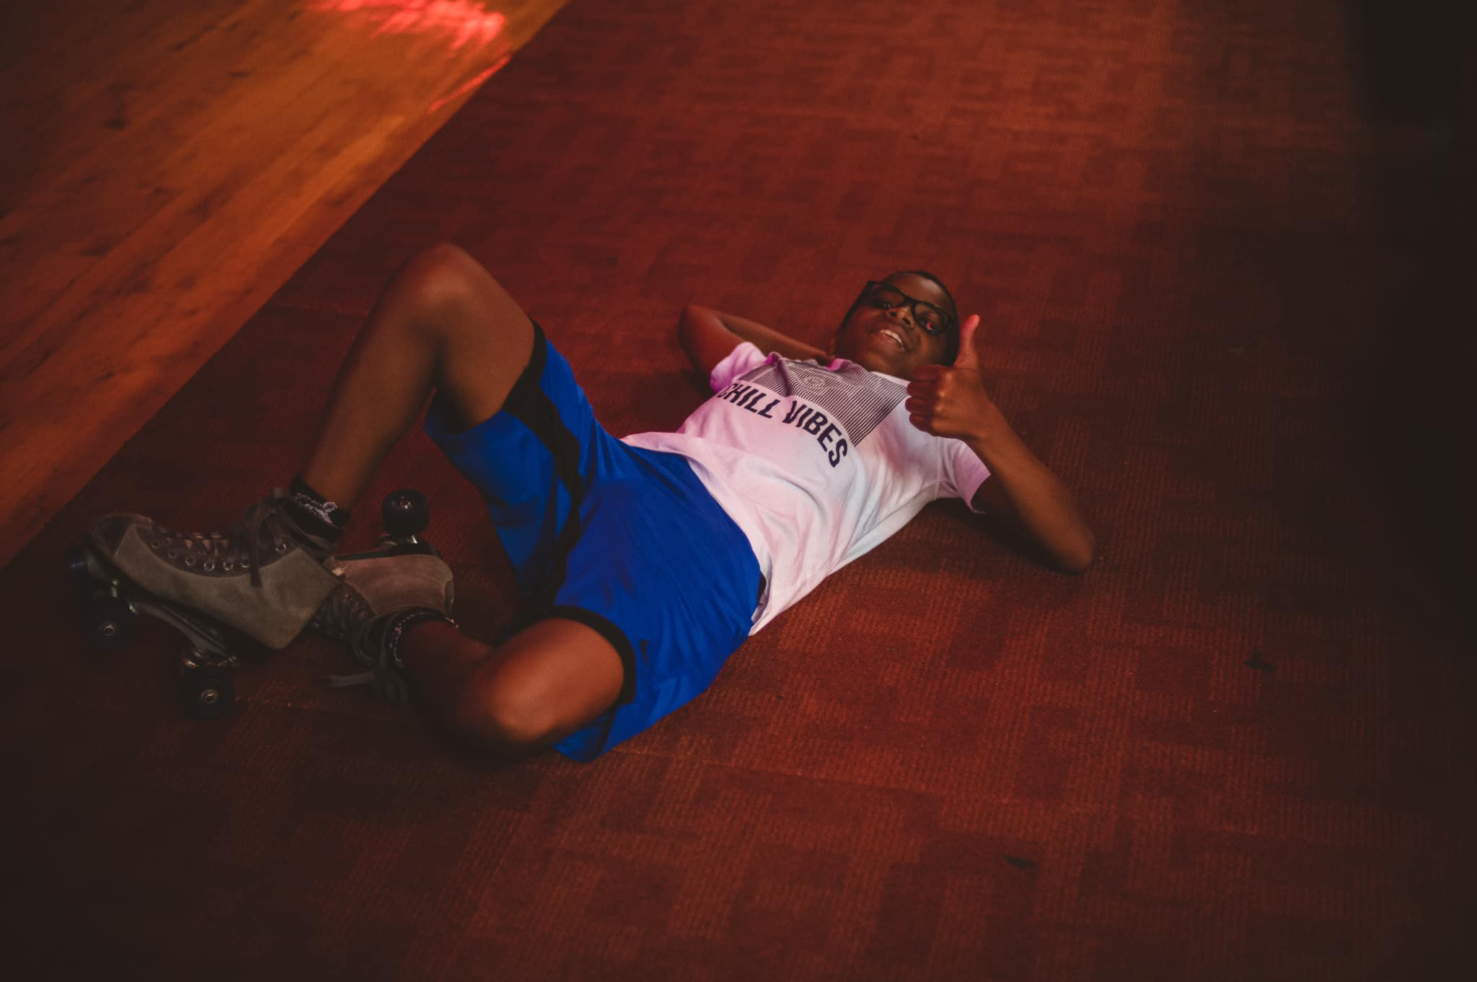
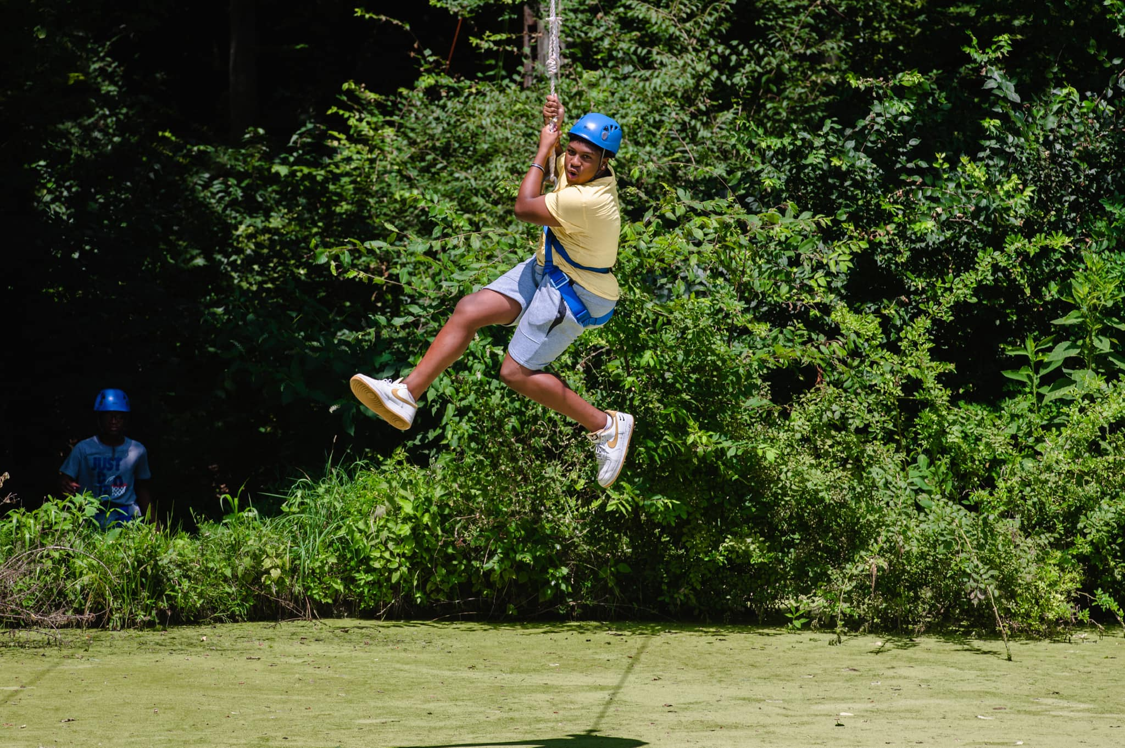
Mentoring
It Takes A Village

Slide 7
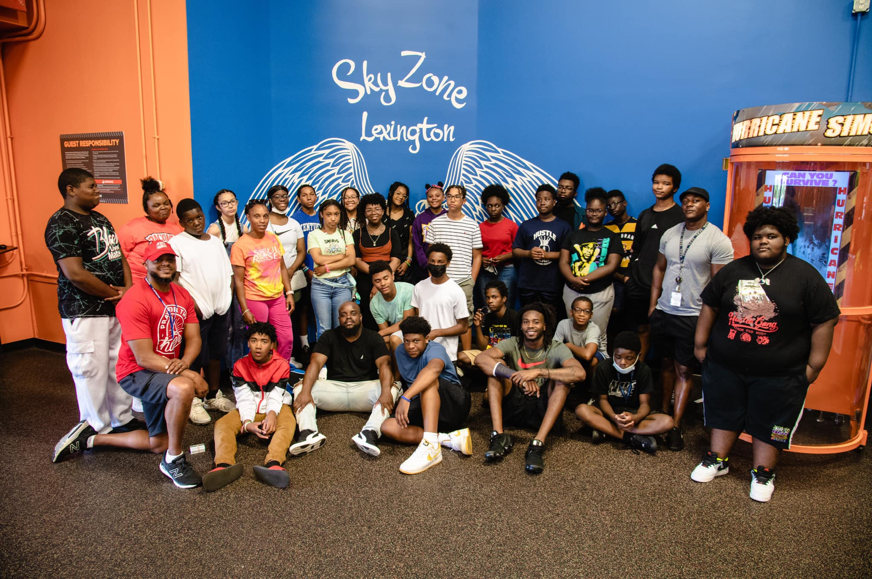
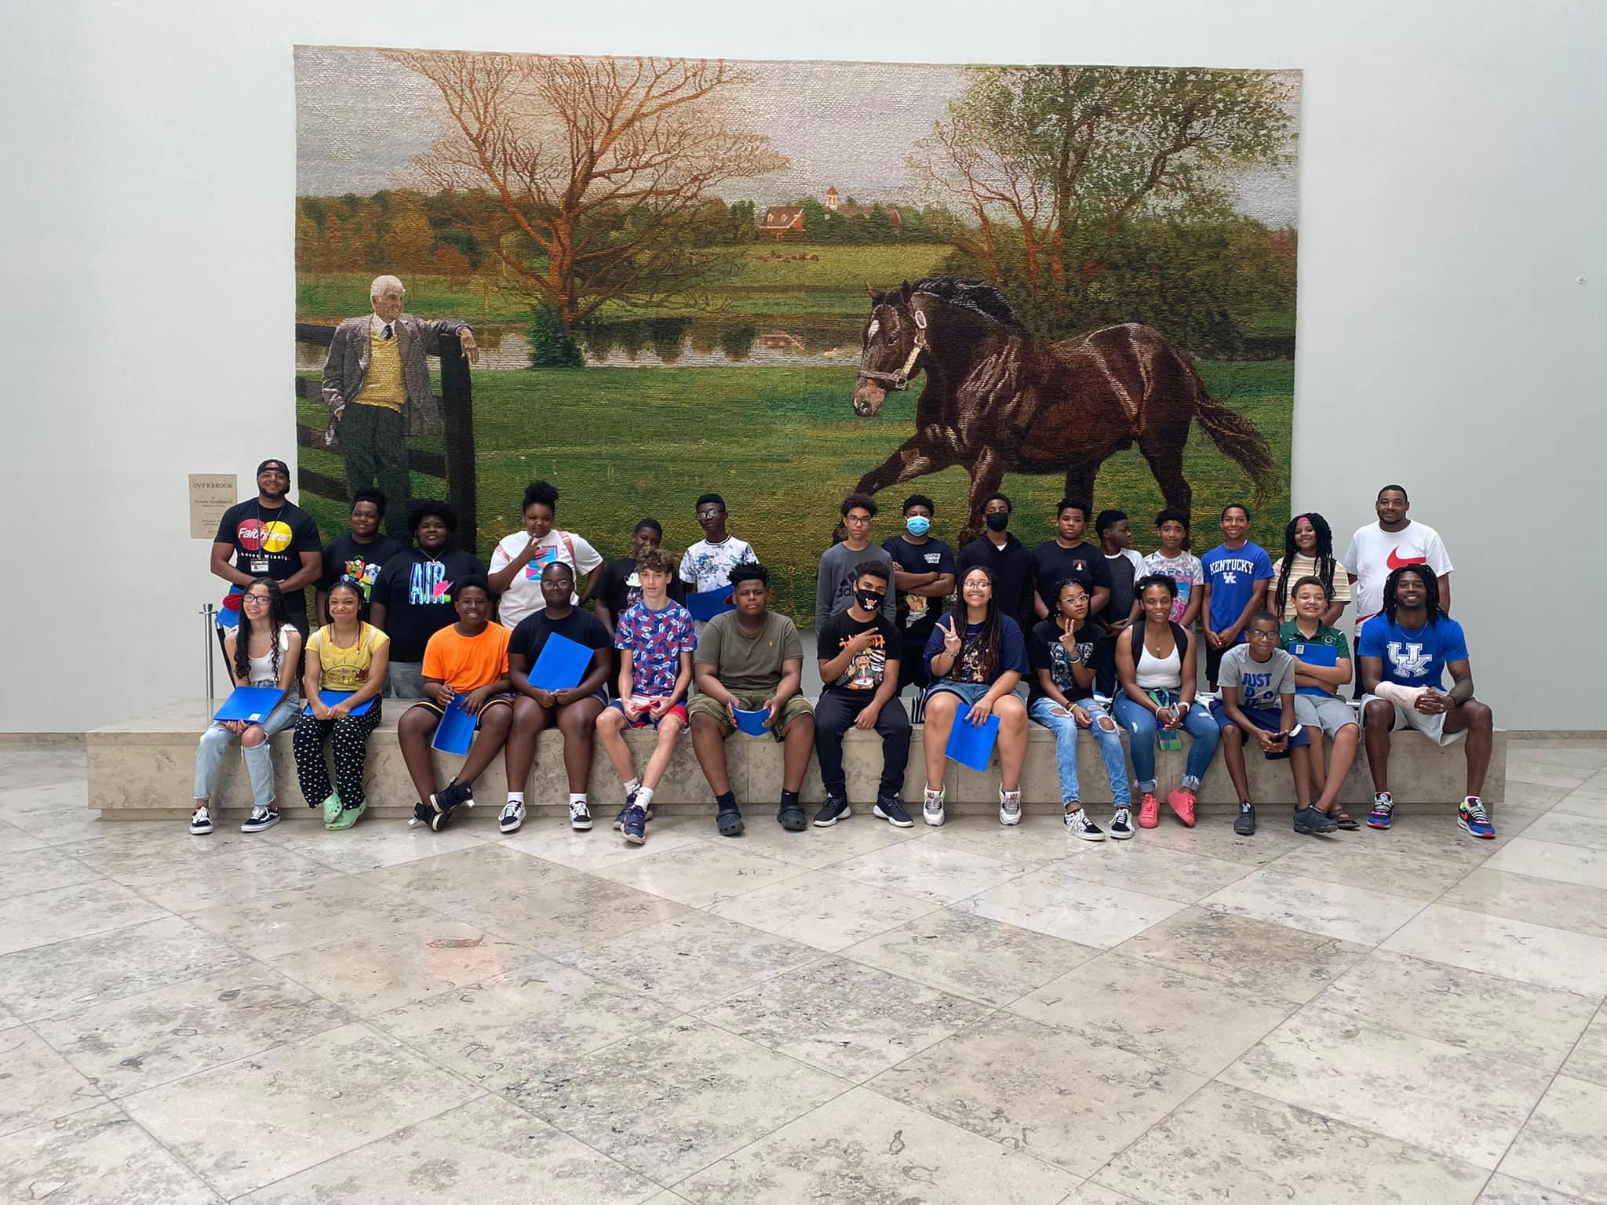
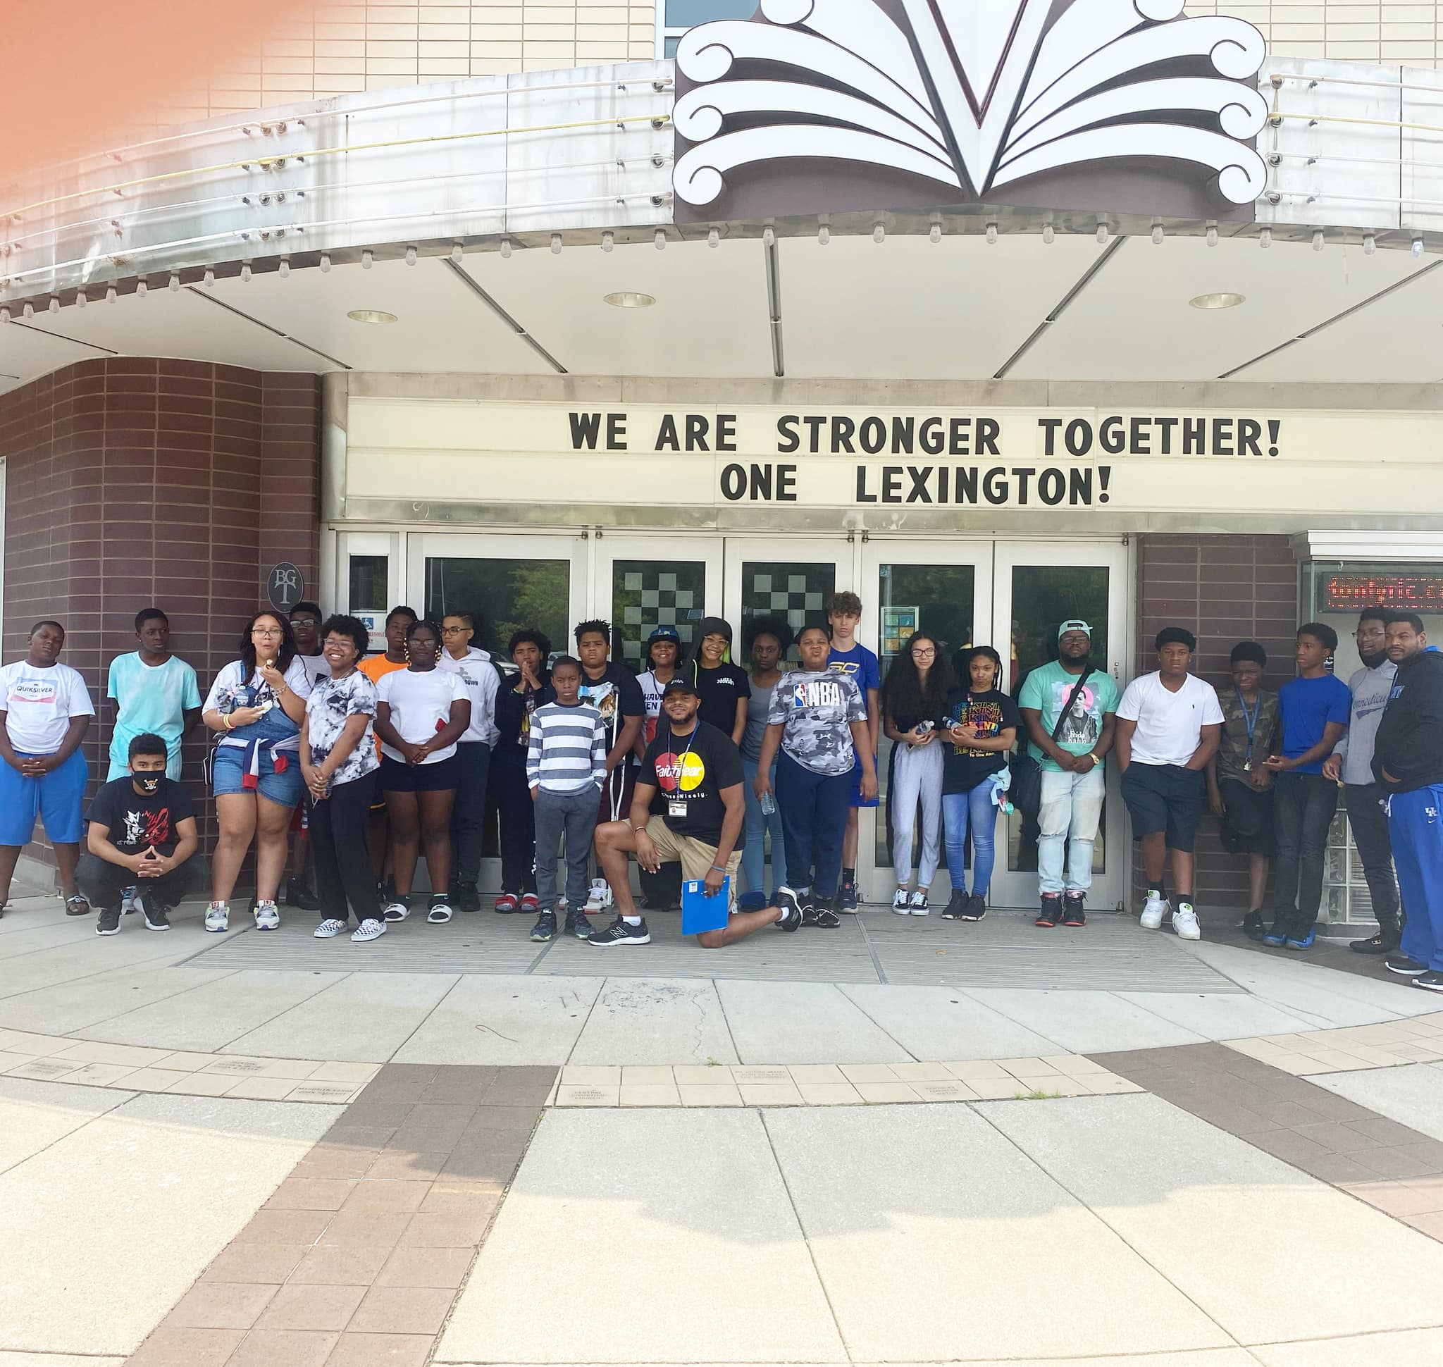
Commitment
It Takes A Village

Slide 8
N.E.W. (Neighborhood Engagement Walks)

Slide 9
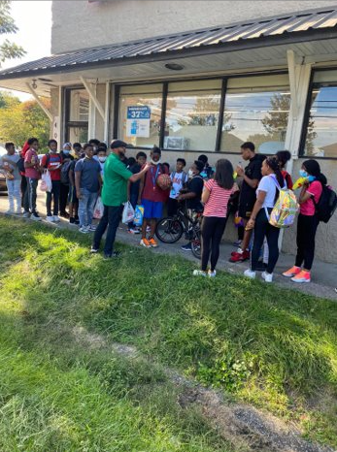
N.E.W. (Neighborhood Engagement Walks
Includes after-school walks for students experiencing barriers on their way home in the afternoons.

Slide 10
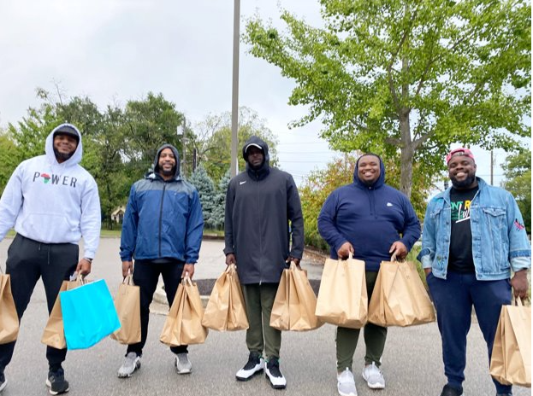
Building Relationships in Community Through Service

Slide 11
We Are ONE
In collaboration with Oneness Sneaker Boutique, we launched the “We Are One” Anti-Violence Essay & Poetry contest for FCPS students in September at Lexington Traditional Magnet School.
Students, in conjunction with their English classes, will have the opportunity to win top notch streetwear and tennis shoes by completing an anti-violence essay, poem, or rap.
Students will also have the opportunity to read their poem or rap on air with Jay Alexander of 107.9 The Beat.

Slide 12
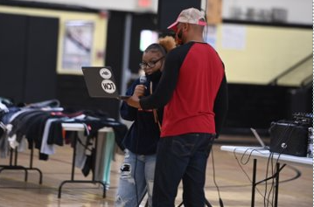
We Are ONE
The goal is to encourage young people to discuss issues that affect them by using platforms to amplify those voices in hopes of inspiring positive change in their community.

Slide 13
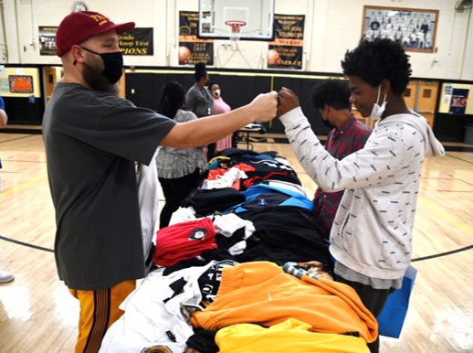
We Are ONE
Rewarding students for using art and self expression as a form of leadership.

Slide 14
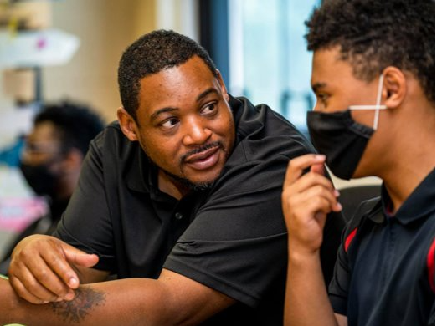
Youth Mediation Collective
When schools or parents contact ONE Lexington regarding mediation of a dispute between students or groups of youth, we have 10-12 diverse mediators to deploy.
Mediators have been formally trained in youth mediation and/or have experience in community youth engagement and resolving conflict.
The goal is to consolidate mediation efforts and provide support to individuals and organizations providing those services.

Slide 15
Safety Net
ONE Lexington acts as the connector between the Lexington Rescue Mission and those seeking services.
ONE Lexington has had success connecting with youth and families impacted by recent gun violence.
In addition to helping families, this has also assisted law enforcement with case investigation.
Hospital Based Violence Intervention Program – Partnership with the University of Kentucky Hospital’s Trauma Unit

Slide 16
New Initiatives at the Lexington Public Library
Provided diversity & inclusion youth training for staff at the Northside branch of the Lexington Public Library.
RESET (Reflect, Evaluate, Specify, Establish, Transform) - Launching new diversion alternative to banning youth from library due to nonviolent behavior issues soon.

Slide 17
Partnership with Parks & Recreation
Currently partnering with Parks & Recreation to engage youth via community centers.
Securing more volunteers
Coordinating with partners to ensure programming in the fall
Promoting and marketing new extended hours of operation at Dunbar Community Center.

Slide 18
Cities United
Cities United has began assessing Lexington.
Their representatives are working with LFUCG to develop a holistic plan to reduce gun violence in Lexington.
Internal and external stakeholders will be involved in every step of the process to develop plans that fit Lexington’s needs.

Slide 19
Other Partnerships in Motion
Be The Change Scholarship with Galls of Lexington
Violence Intervention Group (weekly meetings)
Black Men United
Weekly ONE Lexington Newletter
Weekly Faith Leaders Updates

